Slide 1
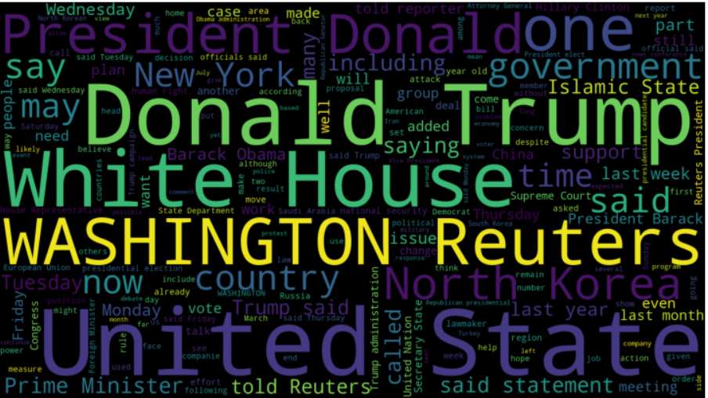

Real News Word Cloud

Slide 2
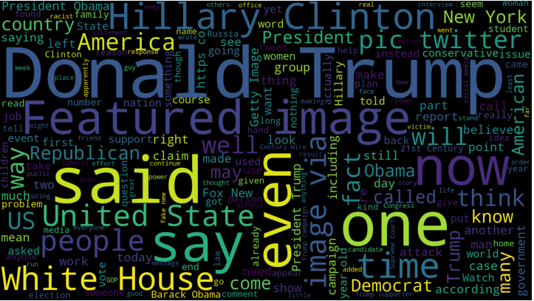

Fake News Word Cloud

Slide 3
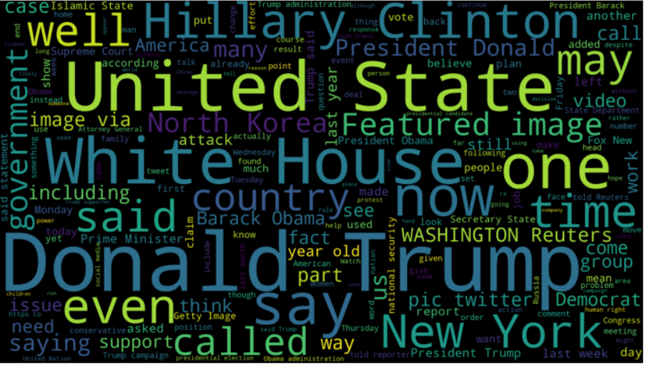

Word Cloud for all data, fake and true.

